Slide 1

Owl Vision: Technical Overview
AJ Johnson

Slide 2
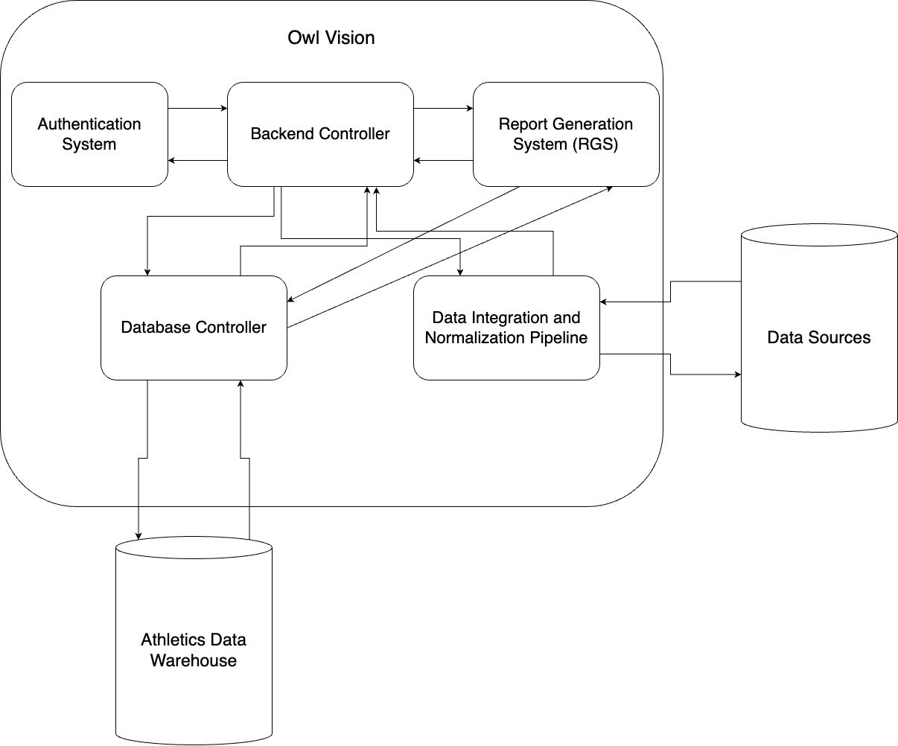
System Architecture
Separation of concerns
Manage database access
Low coupling, High cohesion

Slide 3

Breaking it down
Backend Controller:
Handles basic UI functions.
Routes requests to specific modules.
Authentication System:
Validates user credentials.
Grants access to the system.
Report Generation System (RGS):
Compiles data reports.
Exports results.

Slide 4

Breaking it down Pt. 2
Database Controller
Process read and write requests to athletic data warehouse
Data Integration & Normalization Pipeline
Gather, clean, and rewrite data to athletic data warehouse

Slide 5

Database Selection
Fast, Reliable, Secure
Options:
Postgres
Microsoft SQL Server (MSSQL)
MySQL
Postgres is a very popular database for these kinds of tasks.

Slide 6

Tech Stack
Backend:
Node.js with Express
Database Object Relational Mapper (ORM): Sequelize
Database:
PostgreSQL
Communication Protocols:
RESTful API’s using Express.js
GraphQL: For efficient data queries
Version Control and CI/CD
GitHub for VC
GitHub Actions for CI/CD

Slide 7
Options
Monolithic vs. Multi Container-Based Server
GraphQL & REST hybrid or purely REST
Separate Athletics Database or use existing systems
New or existing authentication system

